Slide 1


Data Visualization Associates
Transforming Data into Actionable Insights
Dashboard Creation
Team 33A
Team lead - Abhay Sahu
Abdullah Zafar
Alimot Ola
Kalyani Kondepu

Slide 2
Introduction
A visual tool that displays key website metrics, such as traffic, performance, and user behaviour.
It helps website owners to monitor and manage their site's activity in real time.
A well-designed dashboard creates a lasting impression
Aims to enhance user experience

Slide 3
Key Decisions and Design Choices
Chose Google Data Studio for its interactive and real-time data visualization capabilities.
Created well-defined categories (e.g., sign-ups, demographics, skills gained) for meaningful insights.
Included filters for date range, country, and status to allow dynamic data exploration
Ensured data updates in real-time or scheduled intervals for accurate reporting.
Designed the dashboard to support strategic decision-making for platform leadership.

Slide 4
Challenges faced
Lot of Incomplete / empty cells in both datasets (User Data & Opportunity Signup Data).
Cleaning and analysis of two datasets.
Handling missing and inconsistent values in the dataset.
Removing duplicates and ensuring data integrity.
Standardizing formats for better readability.

Slide 5
Solutions Implemented
Applied data cleaning techniques to remove duplicates and format inconsistencies.
Standardized data fields for seamless integration with Google Data Studio.
Implemented automated data refresh to keep insights up-to-date.
Integrated filtering options (Date, Country, State, User Status) for personalized insights.
Designed real-time interactive elements, allowing users to drill down into specific data points.

Slide 6
Dashboard overview
PLATFORM ACTIVITY OVERVIEW
Total User sign-up
Total Opportunities sign-up
GLOBAL REACH OVERVIEW
Top 10 Countries by Sign-Ups
Top 10 cities in the US by Sign- Ups
OPPORTUNITY POPULARITY
Most popular opportunity by Sign-ups (Data Visualization)
Most popular opportunity by Completion (Data Visualization)
DEMOGRAPHICS ANALYSIS
Gender Distribution
Student Status Breakdown
SKILLS DEVELOPMENT / FILTER
Most gained Skill on Platform
Date Range, Country, State, Status Breakdown
SCHOLARSHIP IMPACT
Total Scholarship awarded
Breakdown by Opportunity

Slide 7

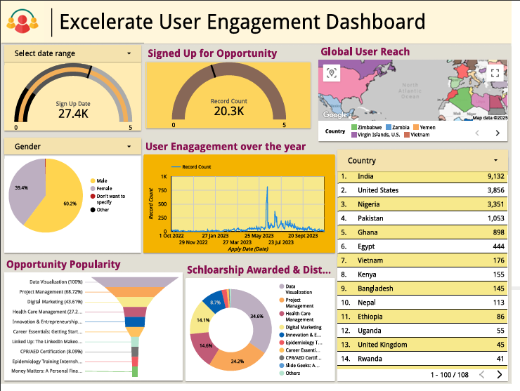
Dashboard overview
Notes:
Shows total number of user signups
Among those users, how many actually signed up for opportunity
Global user reach shows countries where users signed up from
Genders shows the ratio of males to females and other options
User engagement over the whole year shows in which time period throughout the year the most users signed up and availed opportunity
Country tab shows the number of users from each country, starting from the most users to the least
Opportunity popularity shows the number of users sign up for each opportunity
Scholarship awarded and distribution shows the percentage of scholarships of each opportunity in the total scholarship awarded, for example if the budget from scholarship was 100k, the 34 % of that scholarship was won by users in data visualization opportunity and so on.

Slide 8

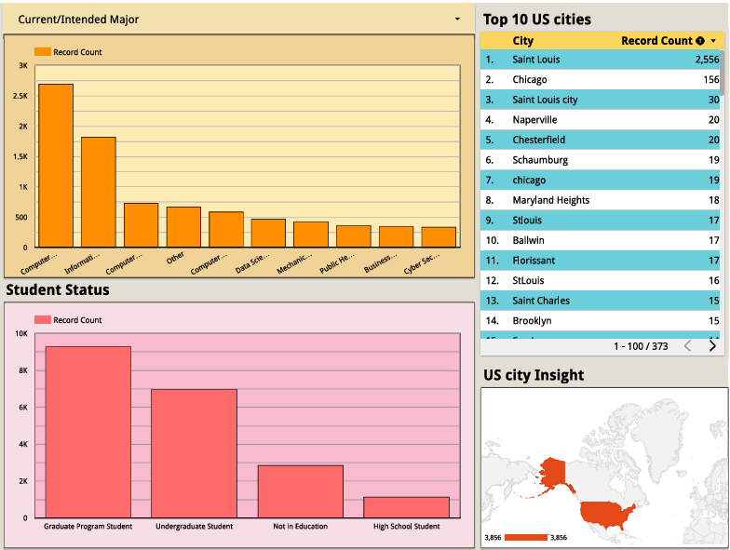
Dashboard overview
Notes:
Current major shows the distribution of users based on their educational backgrounds
top 10 us cities shows the number of users from different cities, sorted in descending order
Student status shows the distribution of users based on their qualification
US city insight visualises the map of US cities based on the number of users

Slide 9
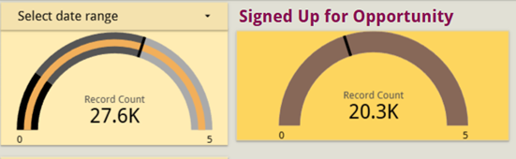
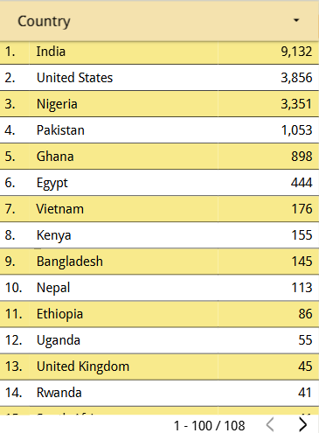
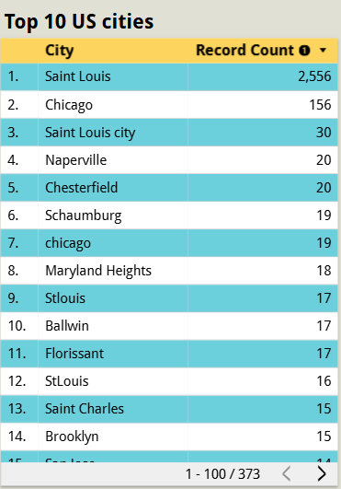
Address Key Question
How many people are signed up on the platform, and how many of those have signed up for opportunities?
What are the cities in the US learners have signed up from?
3. What are the cities in the US learners have signed up from?

Slide 10
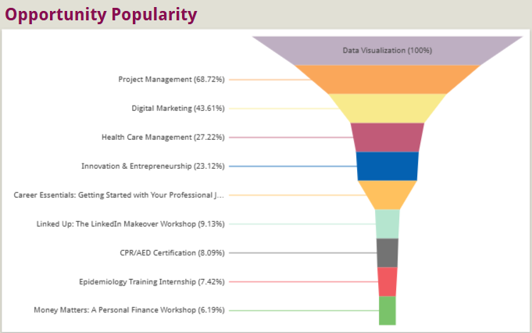
INISIGHT DERIVED
For popular opportunity we have use funnel chart .
Data Visualization (100%) is the most opportunity, meaning all users are engaged with this category.
Project Management (68.72%) has strong interest among users.
Digital Marketing (43.61%) also has significant engagement.
Money Matters: A Personal Finance Workshop (6.19%)

Slide 11
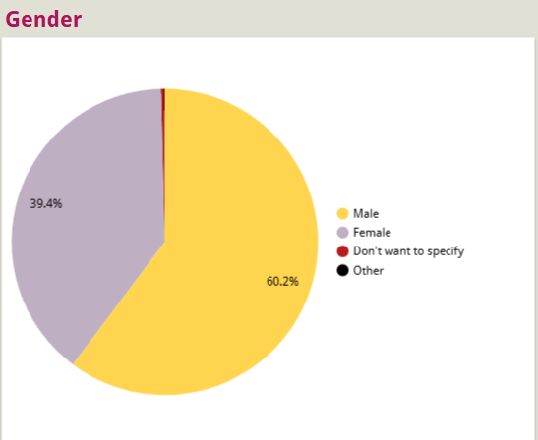
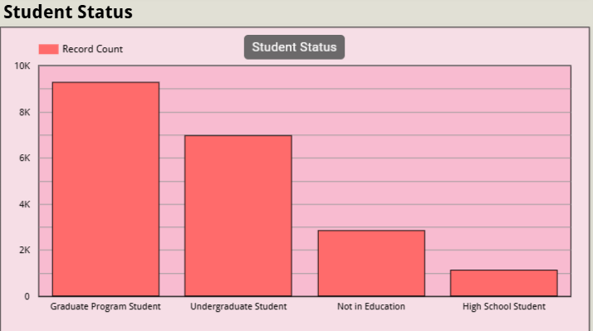
INSIGHT DERIVED
The majority of users (60.2%) identify as male, followed by female users (39.4%).
The gender distribution is fairly balanced, but male users are in the majority.
The highest number of users belong to the Graduate Program Student which is around 9,000 users making it dominant group.
The student who are "Not in Education" has around 3,000 users.

Slide 12
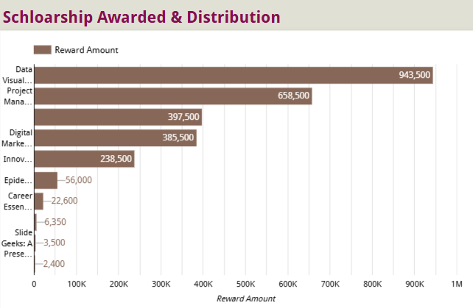
INSIGHT DERIVED
Top Awarded Category:
The "Data Visualization" category received the highest scholarship amount of $943,500.
High Scholarship Categories:
"Project Management" follows with $658,500.
"Digital Marketing" is the third-highest with $397,500.
"Innovation" is awarded $385,500.

Slide 13
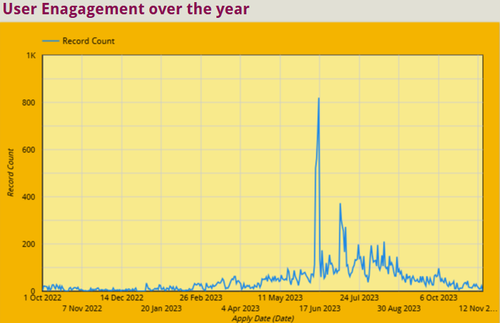
INSIGHT DERIVED
The graph represents User Engagement over the year.
There is a sudden and sharp peak in mid-June 2023, reaching nearly 900-1000 users.
From September 2023 onwards, engagement decreases and stabilizes at a lower level, though it remains higher than the initial phase.
Since engagement drops after the peak, implementing follow-up campaigns or retention strategies can help keep users engaged.

Slide 14

Impact on Decision-Making
The dashboard provides real-time insights into student engagement levels, enabling data-driven decisions on what features to improve or introduce.
By understanding the distribution of users, Excelerate can optimize marketing efforts to attract more high school students or re-engage those not in education.
Insights from this dashboard can drive funding decisions, partnerships, and expansion plans, ensuring alignment with the most active user groups.
Notes:
Assist company in making data-driven decisions, helps to make decision based on data
Dashboards can help users quickly find the information they need
Dashboards can help users identify areas of their website that need improvement
Helps user to grasp complex information quickly by presenting data clearly, hence increasing productivity

Slide 15
iNSIGHT
The dashboard aims to visualize the amount of traffic on Excelerate website
It shows the most engaged opportunities and most in-demand skills
It also shows the amount of scholarship awarded and distributed
Most importantly, it shows the performance of the Excelerate opportunities
Depicts the traffic on each opportunity
Enhanced decision-making with data-backed insights.
Improved user experience by addressing drop-offs and optimizing learning resources.

Slide 16


